Slide 1
NELCCG and Big Lottery Fund – working together for North East Lincolnshire
December 2015
Lisa Hilder, Rachel Stephens and Paula Torres-Silva

Slide 2
Agenda for today
Welcome and introductions
Presentation on the fund
Completing the Expressions of Interest forms
Questions and answers
Booking on one to one sessions (if wished)

Slide 3
Overview
  Introduction to our joint working
  Overall aims
  Areas of interest
  Fund targeting
  Commitment to local VCS organisations
  Outcomes
  What will the fund look like?
  Eligibility
  Process
  Questions

Slide 4
Our joint working
Identified opportunities to work together as funders of local activities
Identified sources of matched funds
Innovative ways to commission and pay for local services
Discussions on shared aims
Shared local intelligence on commissioning activities
Developed priorities localised to North East Lincolnshire

Slide 5
Overall aims
We want:
To prevent ill health
To maximise good health
People to take charge of their own health
The health of people with long term conditions to not deteriorate any further

Slide 6
Areas of interest
We are interested in:
Testing and learning from models of integrated service delivery
Encouraging people to make healthy lifestyle choices (for example – diet, alcohol)
Preventative approaches
Different approaches to working with people who have Chronic Obstructive Pulmonary Disease (COPD), Dementia and Diabetes

Slide 7
Fund targeting
Shared aims to improve health and wellbeing in North East Lincolnshire
Specific conditions are putting pressure on local health and care services
Prevention and mitigation of these conditions will:
Improve health and quality of life for local people
Enable statutory services to target resources most appropriately
Deliver the “shift to the left”

Slide 8
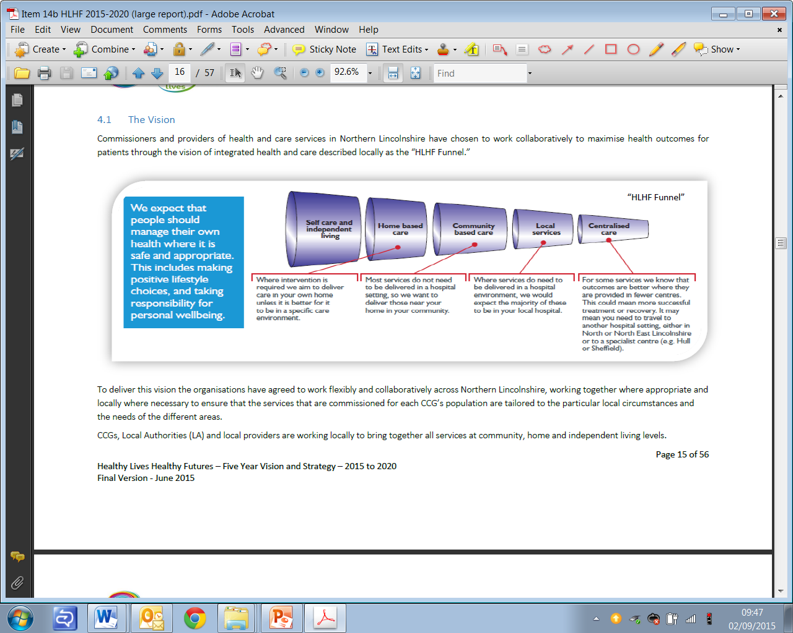

Slide 9
Commitment to local VCS organisations
Both organisations have a VCS commitment and want this programme to strengthen the local VCS.
Big Lottery Fund want to reach new organisations, create a Reaching Communities pipeline and increase awareness of Big Lottery funding

Slide 10
Outcomes
SMART
Specific
Measurable
Achievable
Realistic
Timebound
Outcomes should be centred on reducing the prevalence and impact of Chronic Obstructive Pulmonary Disease(COPD) , Diabetes and Dementia

Slide 11
What will the fund look like?
Medium, multi-year grants – between £20,000 and £50,000 per annum from one to three years – typically £100 000 grant
We expect to make between 10 to 12 Awards
Revenue costs with a small capital element built into it (i.e. computers)
We will not consider applications for existing Reaching Communities project.
We want to test and learn from different approaches. Scaling up an Awards for All project will be encouraged.
When we say different approaches this does not necessarily mean new or innovative. It could mean introducing a model that is being delivered elsewhere in the country.

Slide 12
Eligibility
Organisations with local knowledge delivering benefits to local people in North East Lincolnshire
Organisations who can demonstrate an impact for the conditions we have prioritised
Organisations who can demonstrate clear monitoring and governance of their work
Organisations whose turnover is less than £2million per annum

Slide 13
Process
Expressions of interest
- E-mailed to interested applicants for return 5th January 2016 to lisa.hilder@nhs.net
One to one sessions
  Will take place on 6 and 7 January 2016 in a couple of local venues. This will be a chance for groups to talk to staff from both NELCCG and Big Lottery Fund.
  Contact us to book your place!
Application forms
  Will be sent out to groups on 8 January 2016
  To be returned by 5pm on Monday 29 February 2016

Slide 14
Process (continued)
Assessment
  Each funder assesses the applications they receive according to their standard processes.
Decision making
  Each funder will make funding decisions according to their standard processes. NELCCG will make awards by end of March 2016, Big Lottery Fund’s awards will be made in the new financial year.

Slide 15
Expression of Interest forms

Slide 16
Any questions?

Slide 17
For further information
lisahilder@nhs.net
Paula.Torres-Silva@biglotteryfund.org.uk
Rachel.stephens@biglotteryfund.org.uk

